Slide 1


Final Presentation
Mechanical Science & Engineering
Automated Neuronal Sample Handling Platform
Daewon Hong, Alex Karrow, Daniel Liu, Rohan Mandhan, Prateek Rout
December 10, 2024

Slide 2

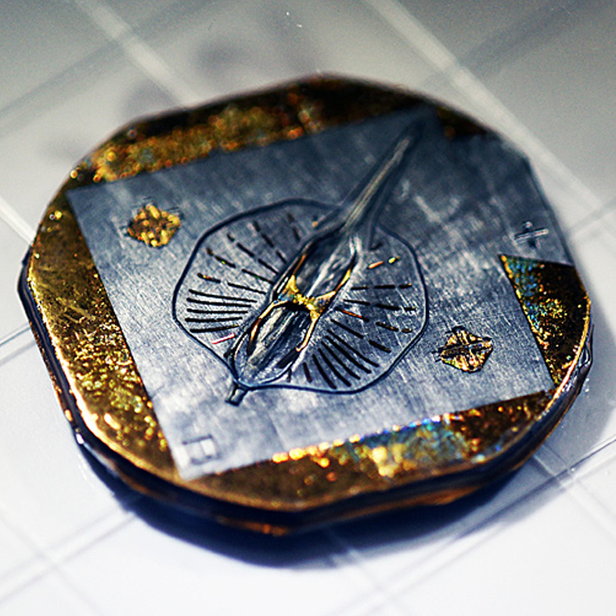
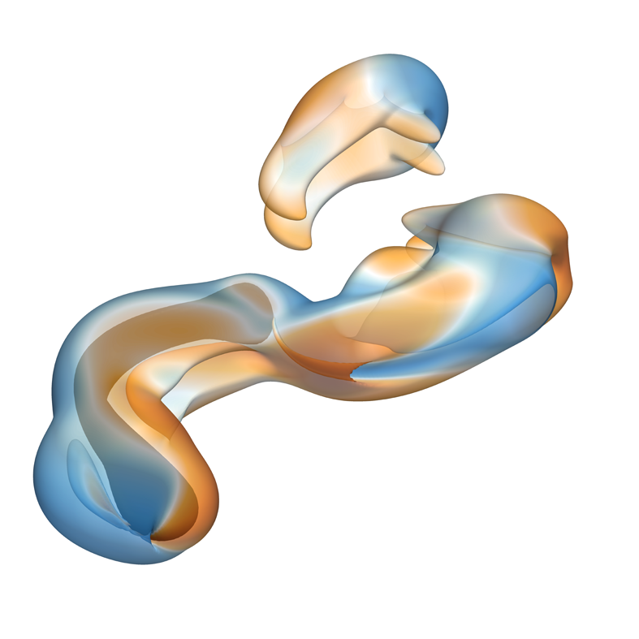
INTRODUCTION & DELIVERABLES - Rohan
Gazzola Lab @ UIUC
Innovating in the crossover between engineering and biology
Soft creatures, cyborgs, fluid dynamics, and more
Mind in Vitro project: Computation with Neurons
Automated Neuronal Sampling Platform
Utilize a given Automated Mobile Robot (AMR) to transport a sample to and from a testing apparatus
2-DOF mechanism
Ensure automation, reliability, and sterility
MECHANICAL SCIENCE & ENGINEERING
GRAINGER ENGINEERING
Notes:
bring sample of

Slide 3

Animation
MECHANICAL SCIENCE & ENGINEERING
GRAINGER ENGINEERING

Slide 4
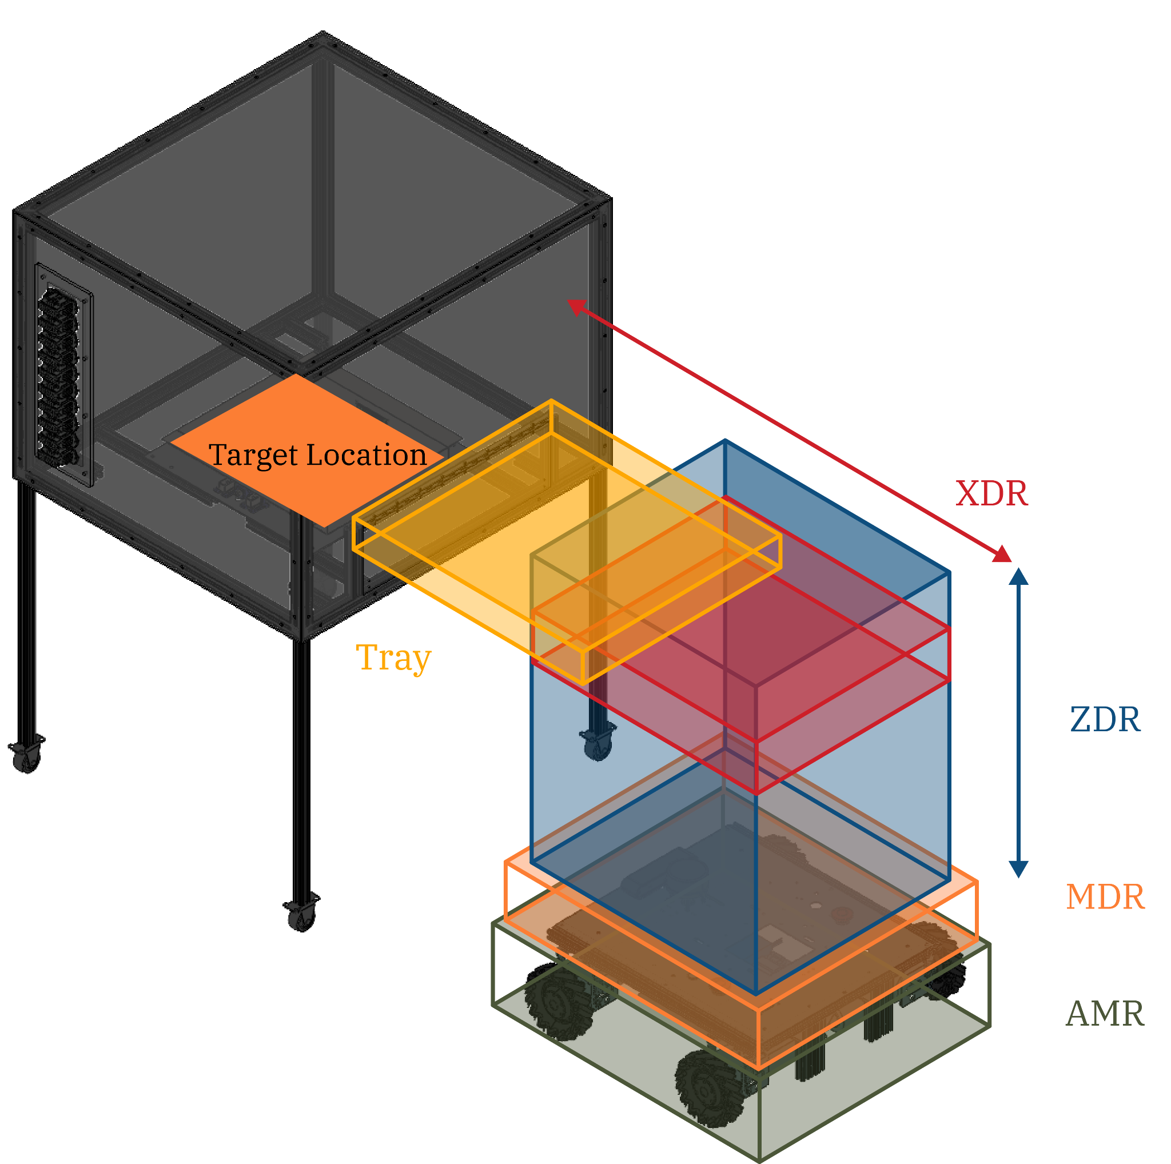
SYSTEM CONSTRAINTS / SUBSYSTEMS - Rohan
Testing Apparatus Height (Z-ext.): 500 mm
X-Extension: 450 mm
Payload Cantilever Weight: 5 kg
AMR load capacity: 60 kg
AMR area: 500 x 550 mm
MECHANICAL SCIENCE & ENGINEERING
GRAINGER ENGINEERING

Slide 5
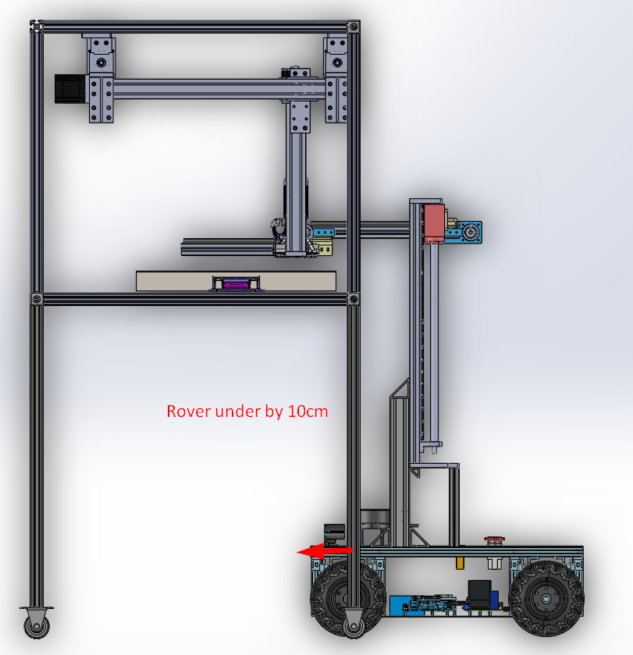
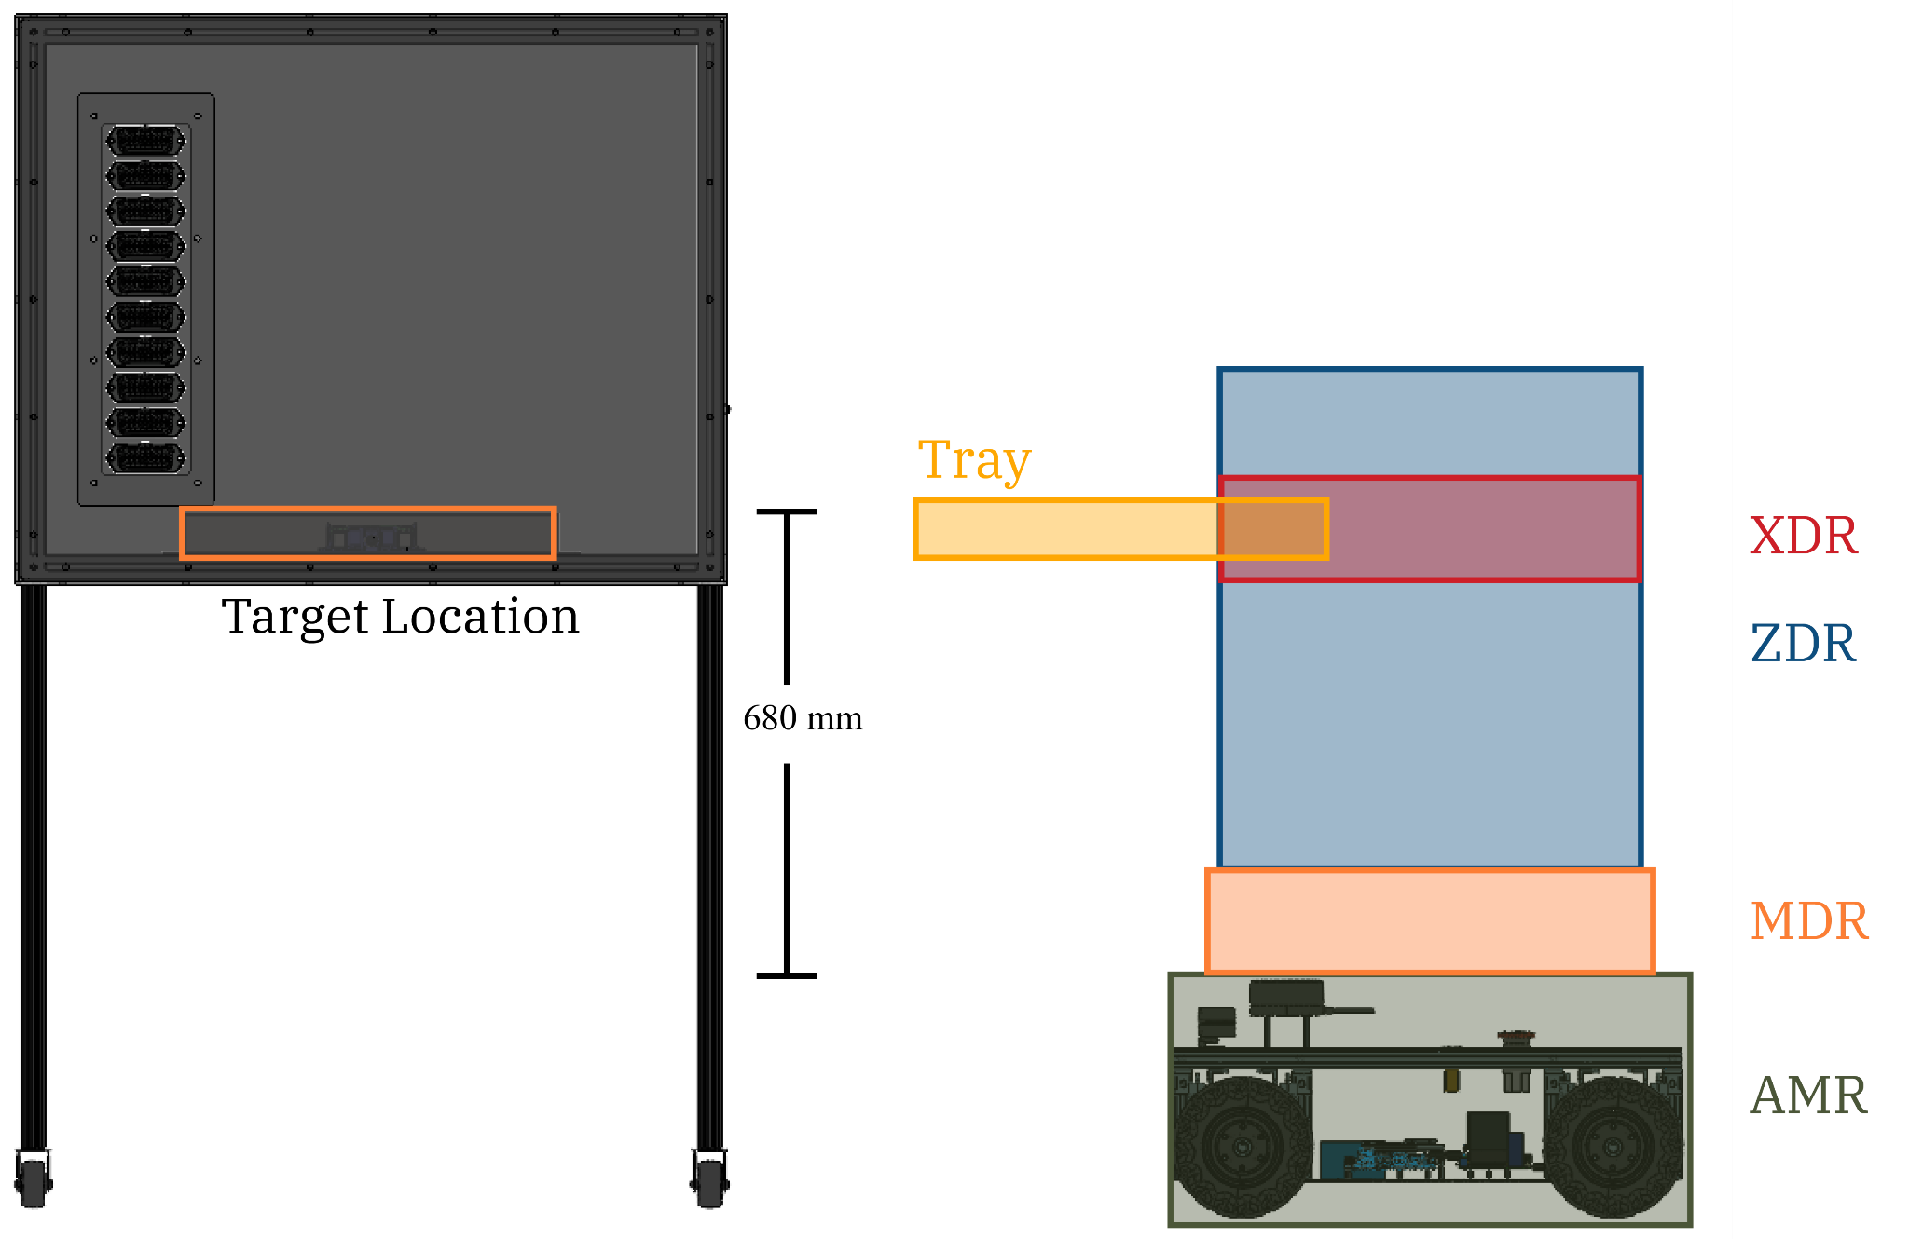
ANSHP-CAD - Rohan
MECHANICAL SCIENCE & ENGINEERING
GRAINGER ENGINEERING

Slide 6
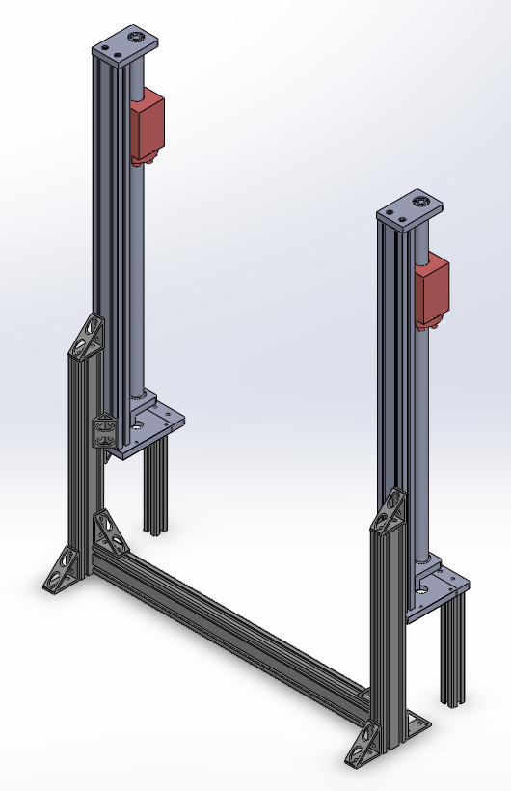
MODULAR STRUCTURE & Z-DIRECTION (MDR & ZDR) - Dan
Modular Structure
Height buffer and modularity
300 mm standoff height
8020 Aluminum Extrusions
Optimized structure, minimizing weight
Z-Direction Extension (ZDR)
Two lead screws mounted to MDR using ½” aluminum plates & aluminum L-brackets
400 mm travel
Carriage raises enclosure & XDR
MECHANICAL SCIENCE & ENGINEERING
GRAINGER ENGINEERING
Notes:
bring lead screw

Slide 7
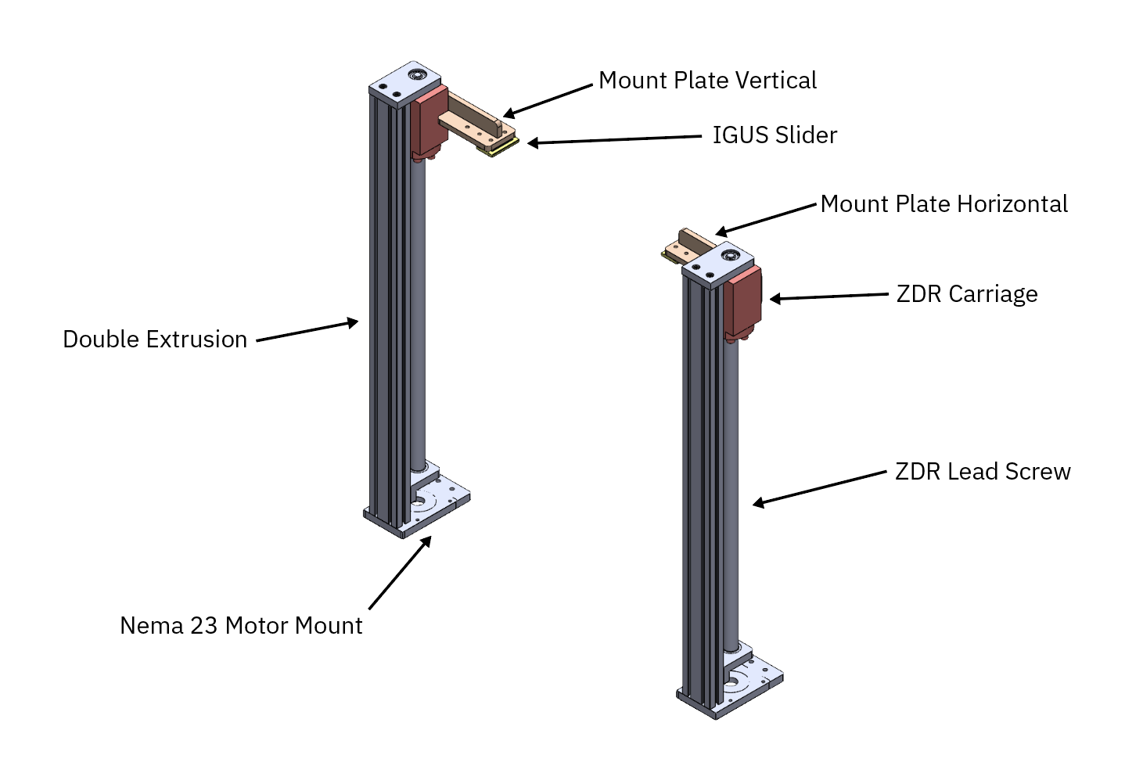
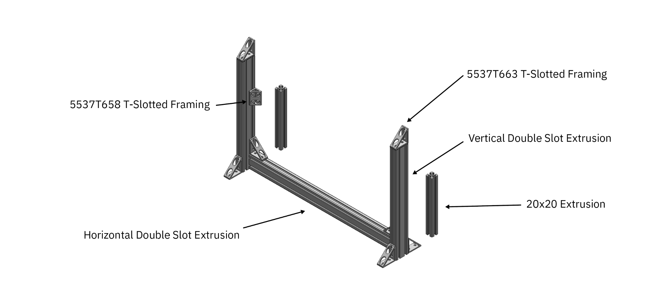
MDR & ZDR Overview - Dan
MECHANICAL SCIENCE & ENGINEERING
GRAINGER ENGINEERING
Notes:
bring lead screw

Slide 8
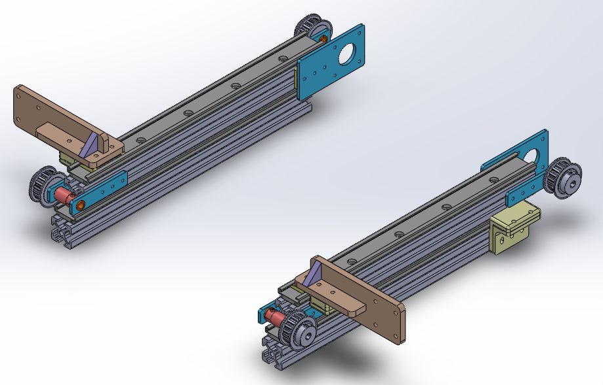
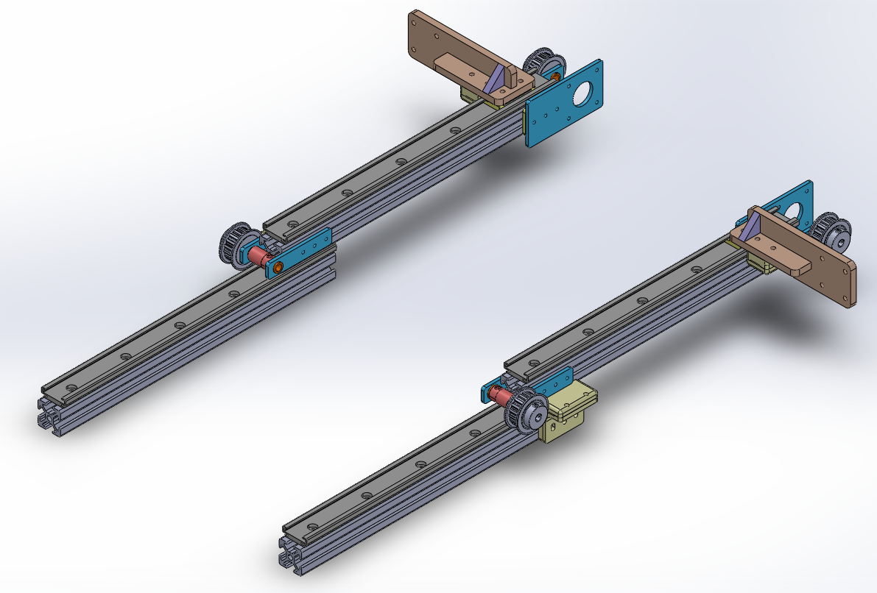
X-DIRECTION (XDR) - Dan
Two-Stage, Belt-Driven Telescoping Mechanism
500mm reach, meeting 450mm requirement while allowing for play
Aluminum + plastic components to limit weight
8020 Aluminum Extrusion with off-the-shelf linear sliders
Simple packaging interface with enclosure + ZDR
Comfortably packaged on top of AMR when fully retracted
Custom Belt Clamps & Motor plates, Welded ZDR mounts
MECHANICAL SCIENCE & ENGINEERING
GRAINGER ENGINEERING
Notes:
bring lead screw

Slide 9
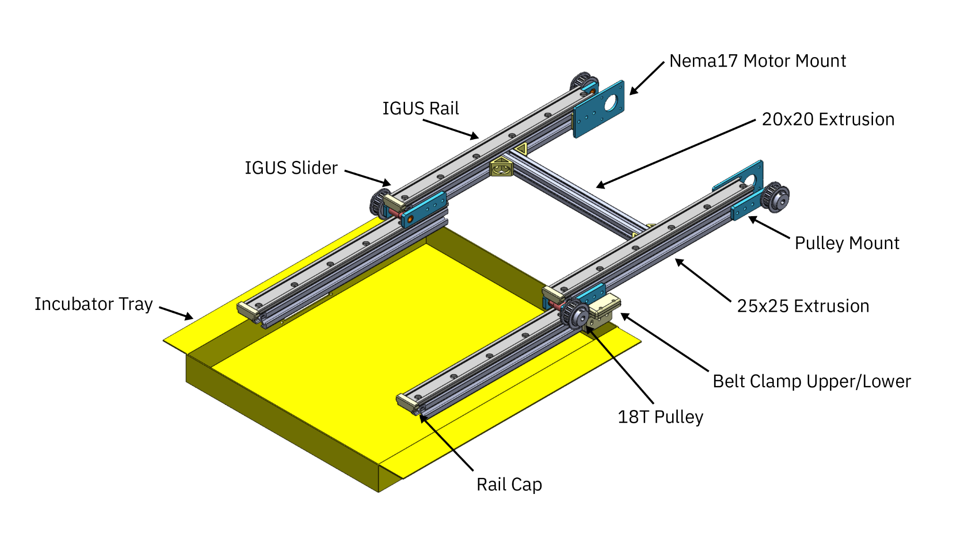
XDR overview - Rohan
MECHANICAL SCIENCE & ENGINEERING
GRAINGER ENGINEERING
Notes:
bring lead screw

Slide 10
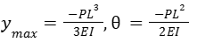
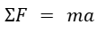
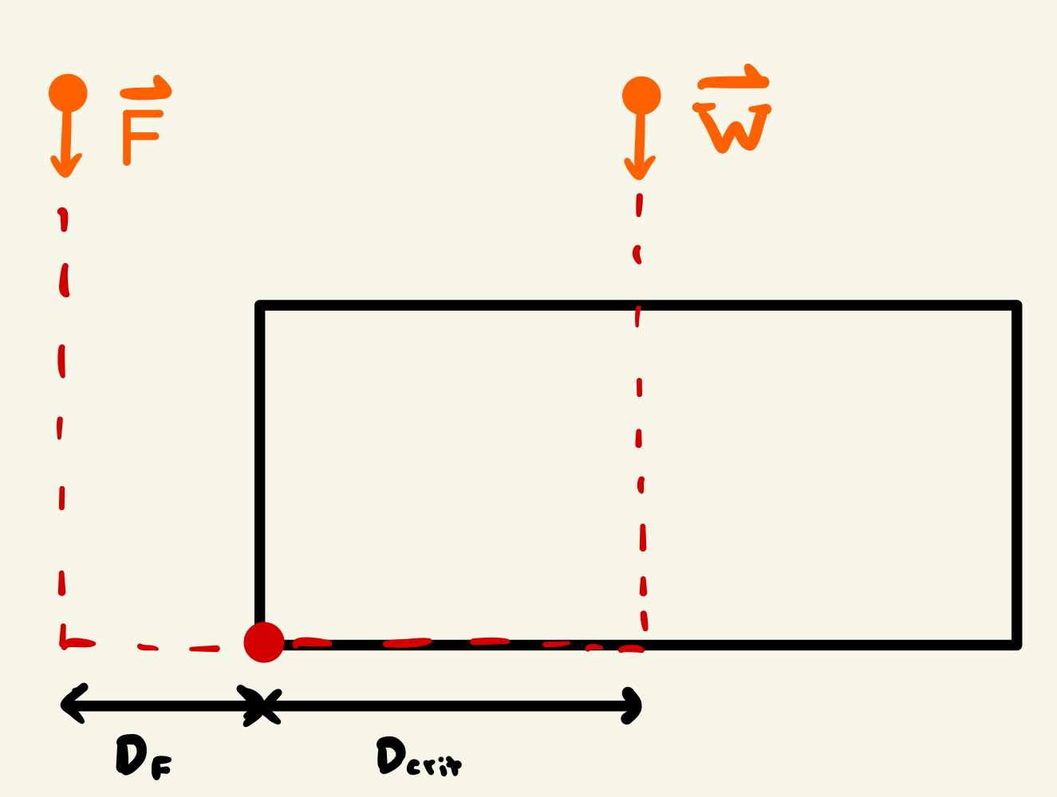
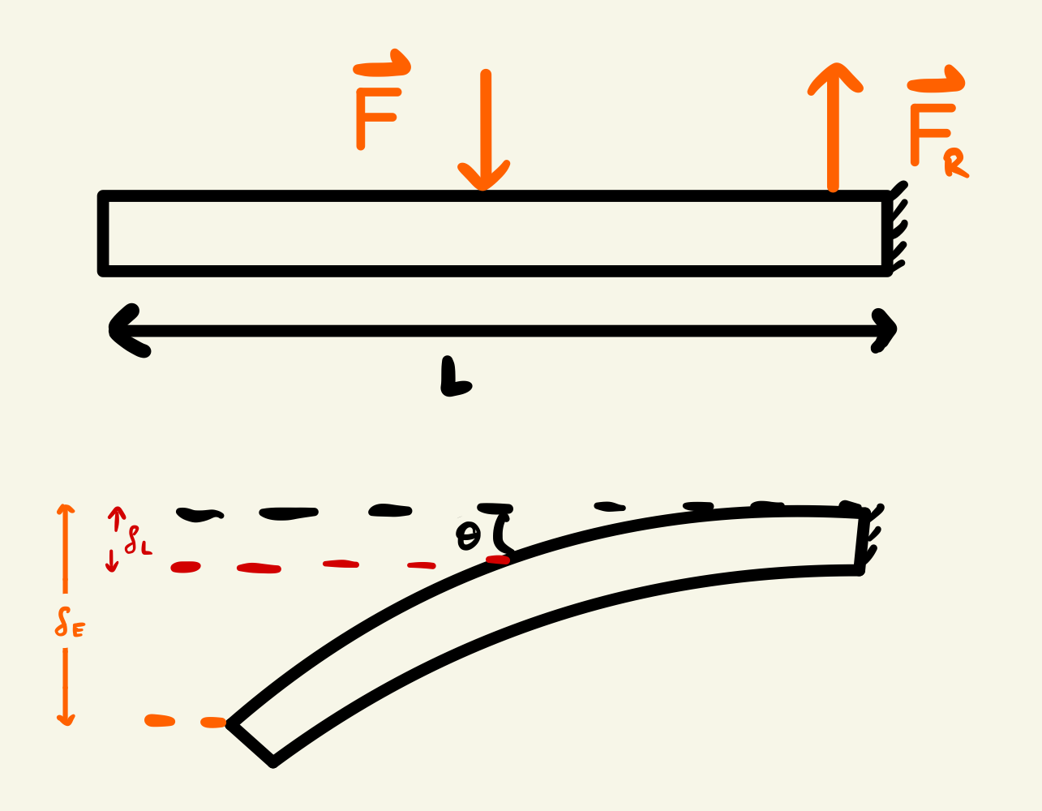
Governing Equations & Calculations - Rohan
Tipping:
Total weight: 320.46 N
Applied force: 49 N
Critical distance: 23.2 mm
True CoG: 16.7 mm
Deflection:
P = 49 N
L = 0.5 m
E = 50 MPa
I = 17675 m⁴
Displacement: 3.9 mm
MECHANICAL SCIENCE & ENGINEERING
GRAINGER ENGINEERING

Slide 11
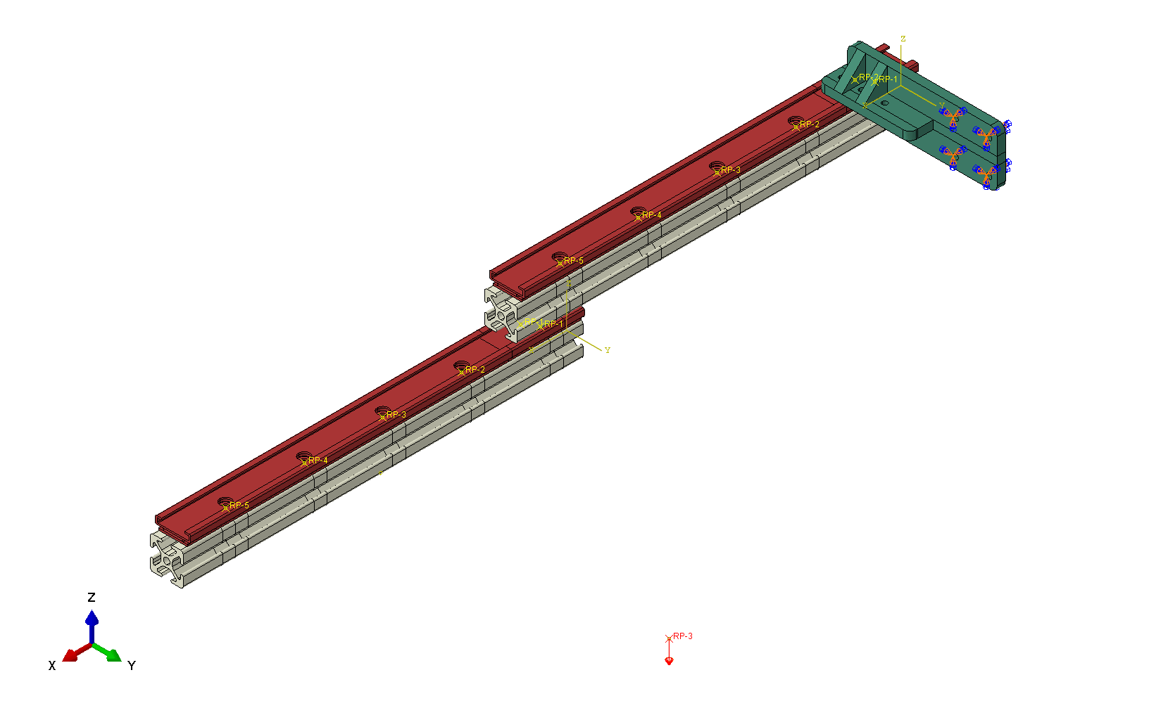
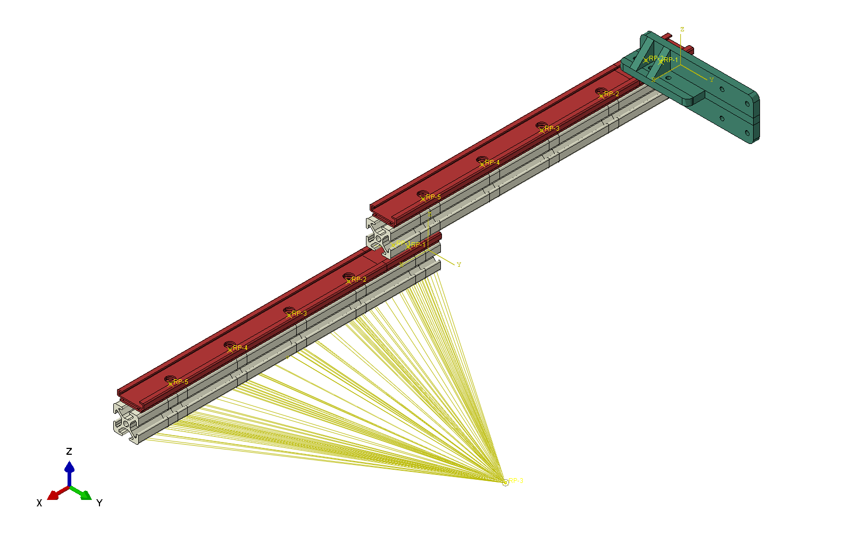
XDR FINITE ELEMENT ANALYSIS (FEA) - Daewon
FEA Objectives:
Load on linear sliders cannot exceed 600N
End-effector displacement
Parts/Materials:
ZDR-XBAR / 6105 Aluminum
ZDR-RAIL / Unalloyed Aluminum
ZDR-BRACKET / 1018 Aluminum
Constraints:
Coupling / End-Effector Edge → LP / Rail → Xbar
Surface Interaction / Rail → Xbar
Boundary Conditions:
Displacement & Rotation / U1U2U3UR1UR2UR3
Loads:
U3 = -98.1 N
20/2 = 10kg load applied to the end-effector
MECHANICAL SCIENCE & ENGINEERING
GRAINGER ENGINEERING

Slide 12
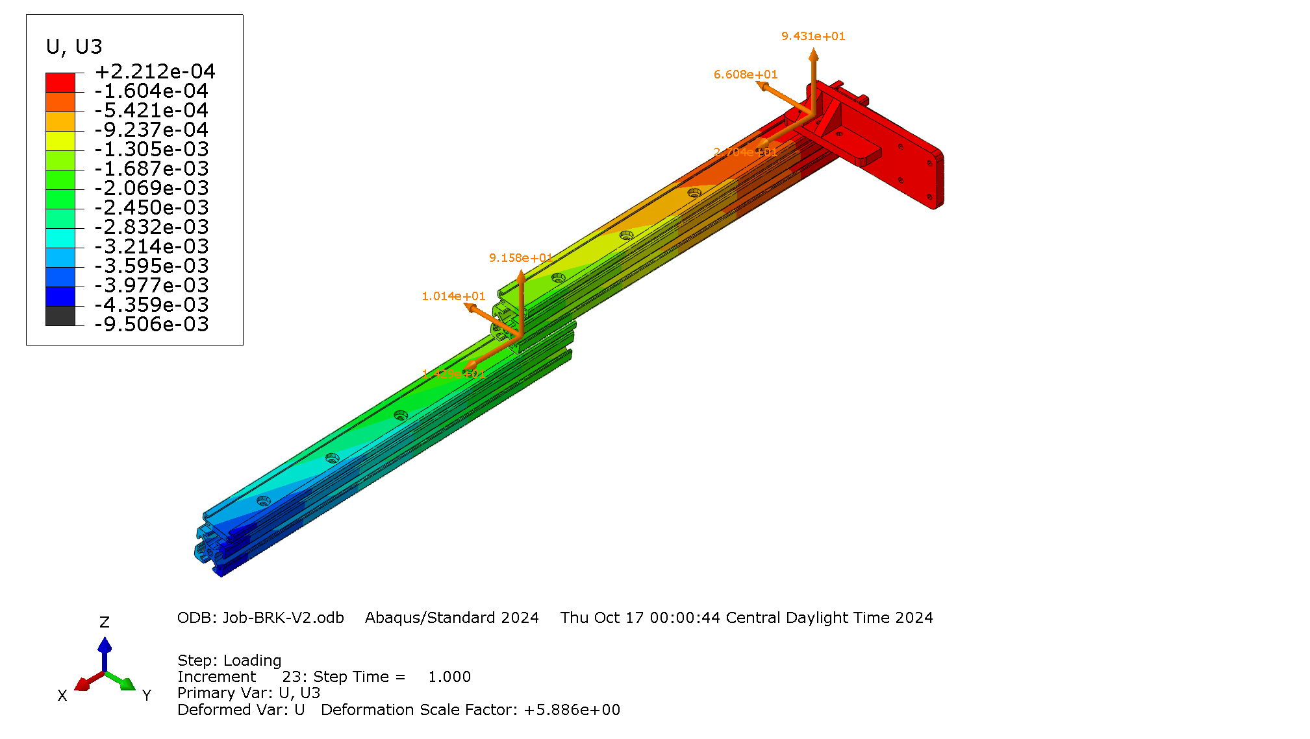
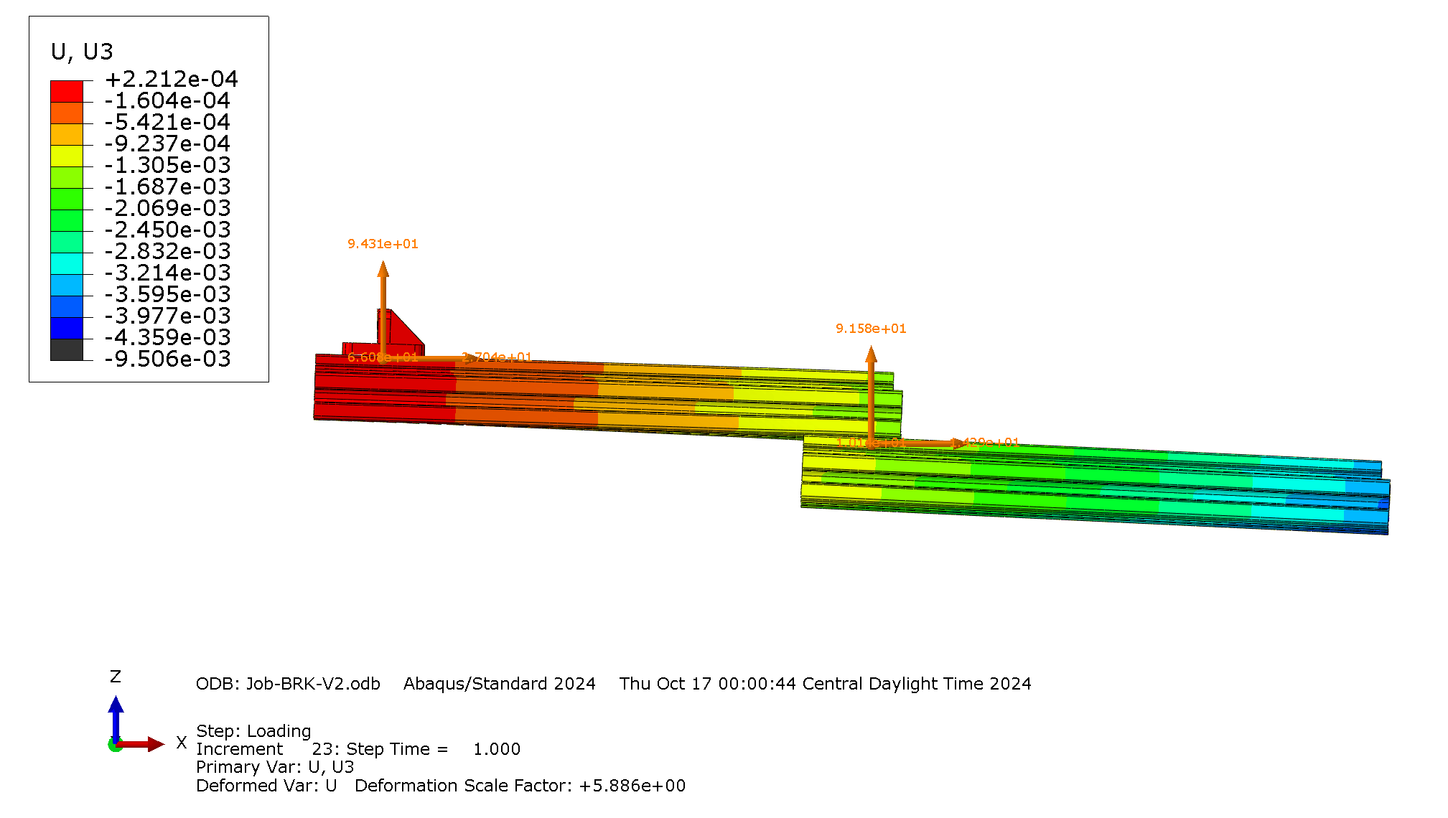
XDR FEA RESULTS - Daewon
U3 Max. Displacement = 4.3 mm / Max Load = 118 N
MECHANICAL SCIENCE & ENGINEERING
GRAINGER ENGINEERING
Notes:
bring lead screw

Slide 13
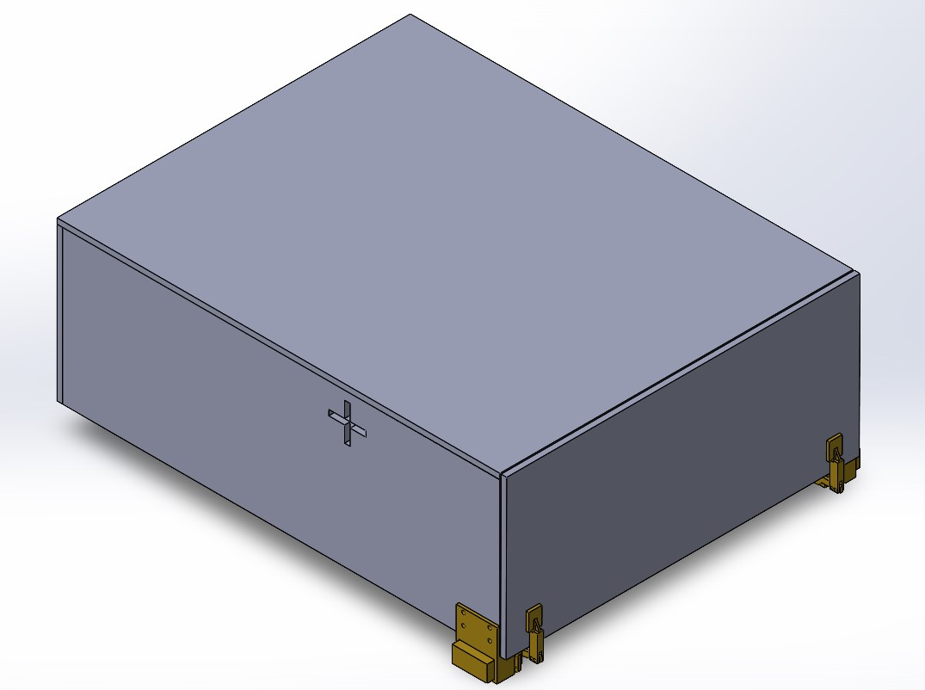
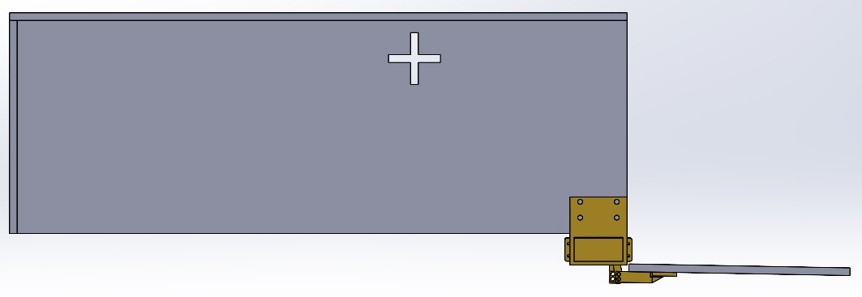
Sterile Enclosure - Alex
Integrated Enclosure
Polycarbonate for strength, weight and accessibility
Semi-airtight housing
Modular structure for ease of access
Dual Servo-powered Mailbox mechanism
MECHANICAL SCIENCE & ENGINEERING
GRAINGER ENGINEERING
Notes:
bring lead screw

Slide 14
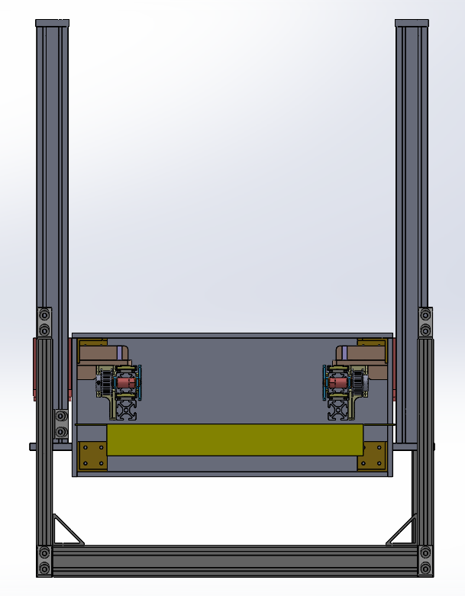
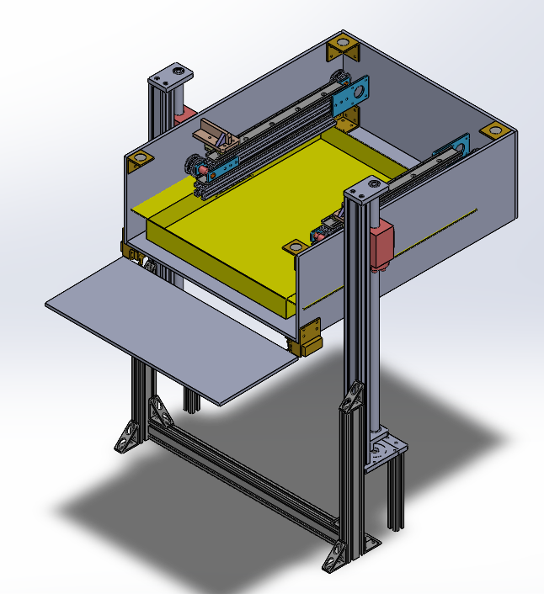
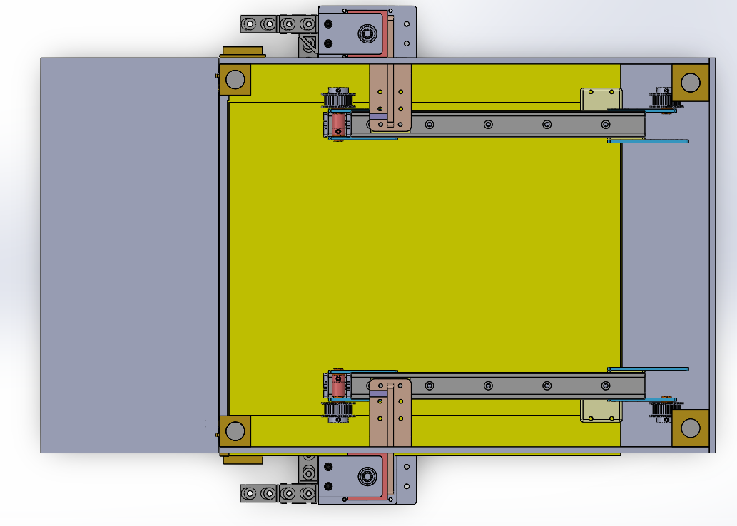
Sterile Enclosure - Alex
Integrated Enclosure
Attaches to ZDR through cross-slot mount
Neodymium Magnets connect top panel
XDR housed inside Enclosure
Assumption of no direct load
MECHANICAL SCIENCE & ENGINEERING
GRAINGER ENGINEERING

Slide 15
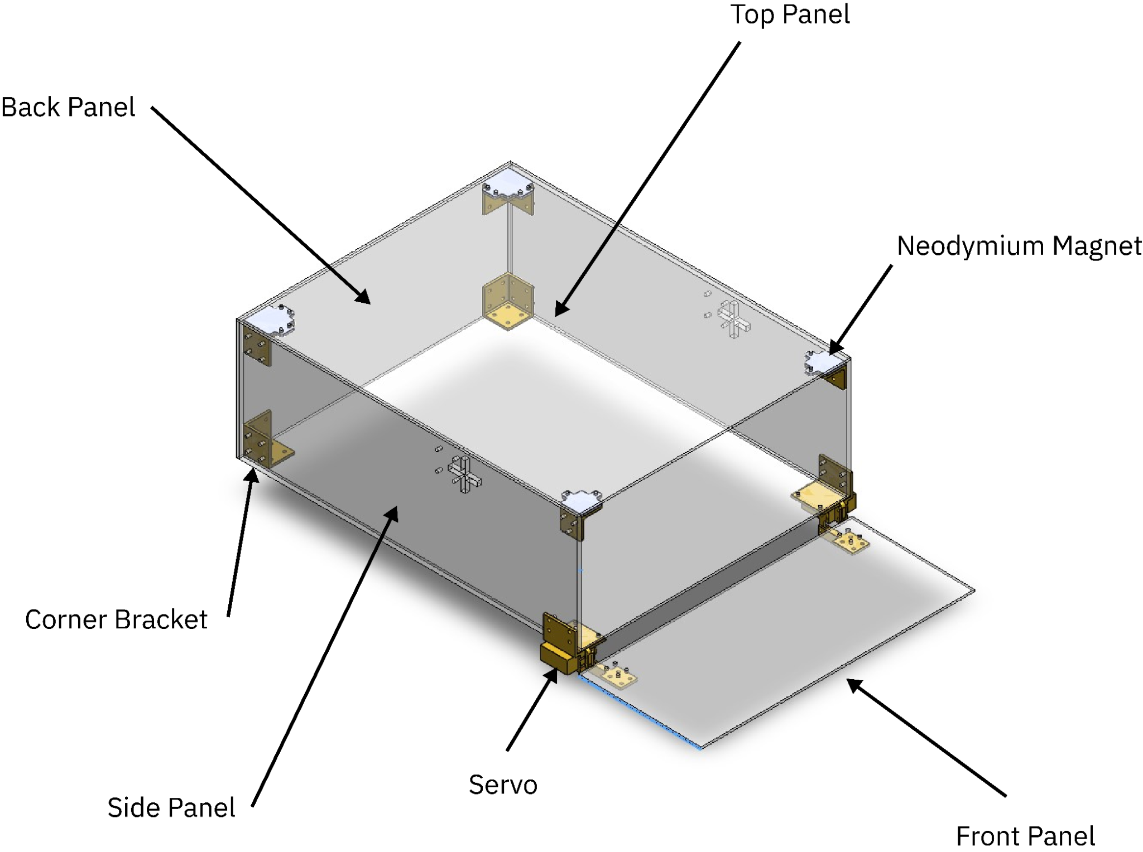
Labeled Enclosure - Alex
MECHANICAL SCIENCE & ENGINEERING
GRAINGER ENGINEERING

Slide 16
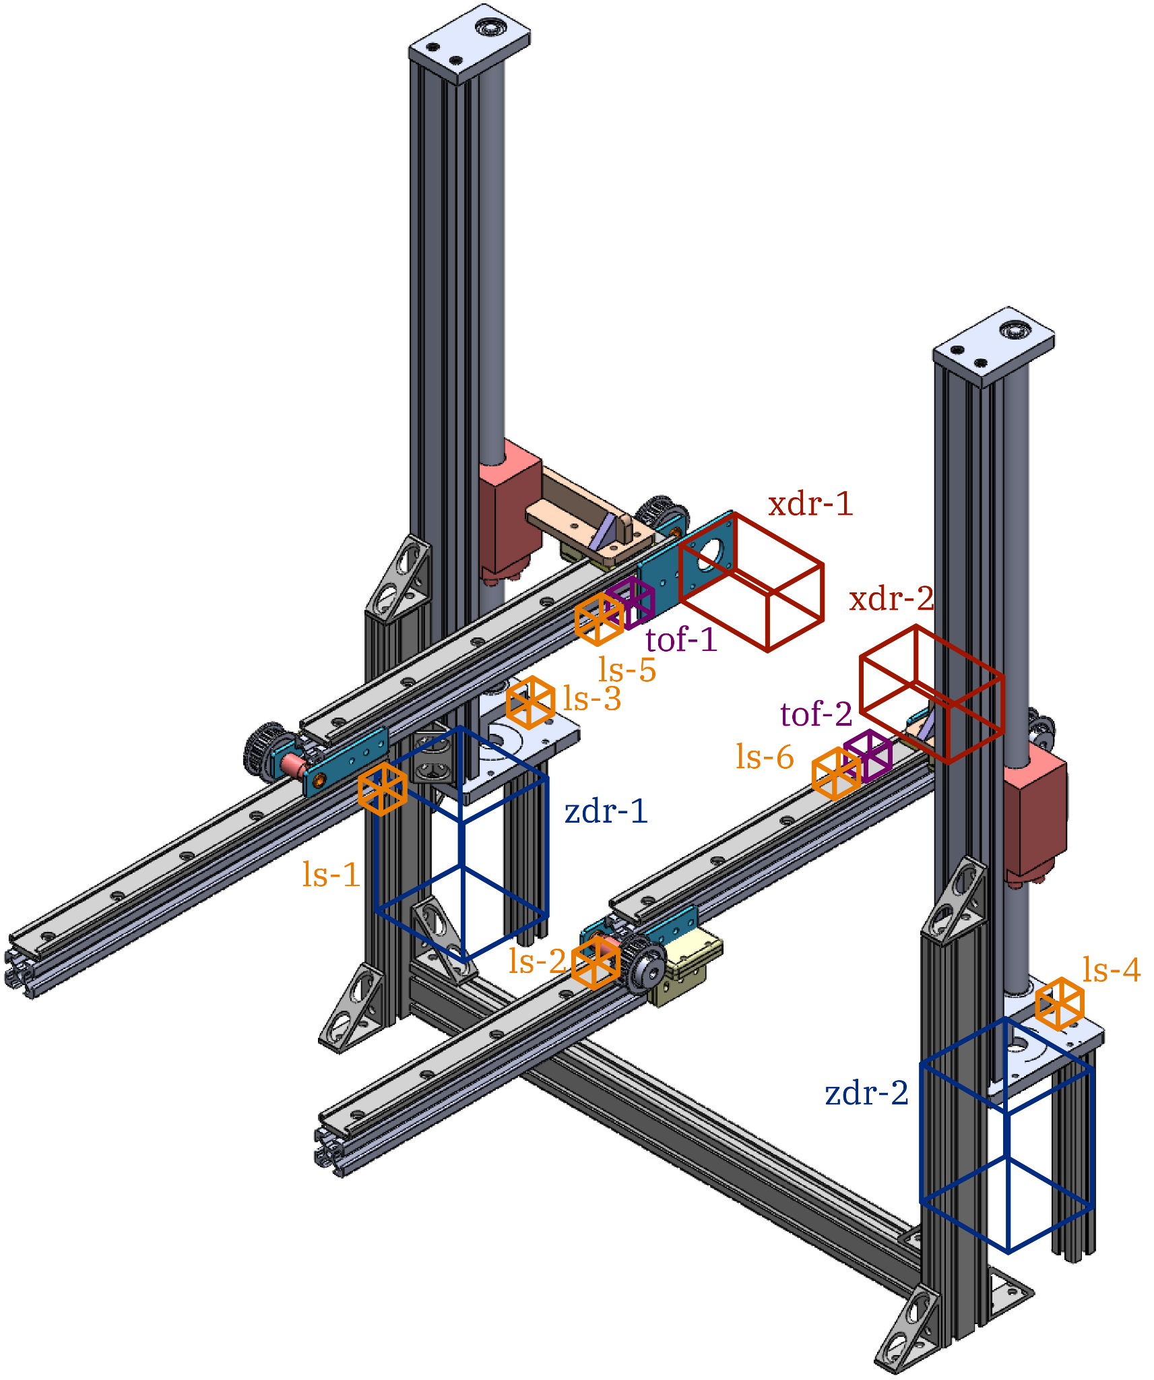
Sensors & Electronics - Prateek
Motors: (6x)
XDR (2x): 0.65 Nm Stepper with Encoder
ZDR (2x): 2 Nm Stepper with brake
Enclosure (2x): 35 kg-cm Servo with 270° range
Time of Flight (ToF) Sensors: (2x)
Define Absolute ZDR positions
Reduces risk of motors skipping steps
Limit Switches: (6x)
Used for homing and defining reference points
MECHANICAL SCIENCE & ENGINEERING
GRAINGER ENGINEERING
Notes:
bring lead screw

Slide 17
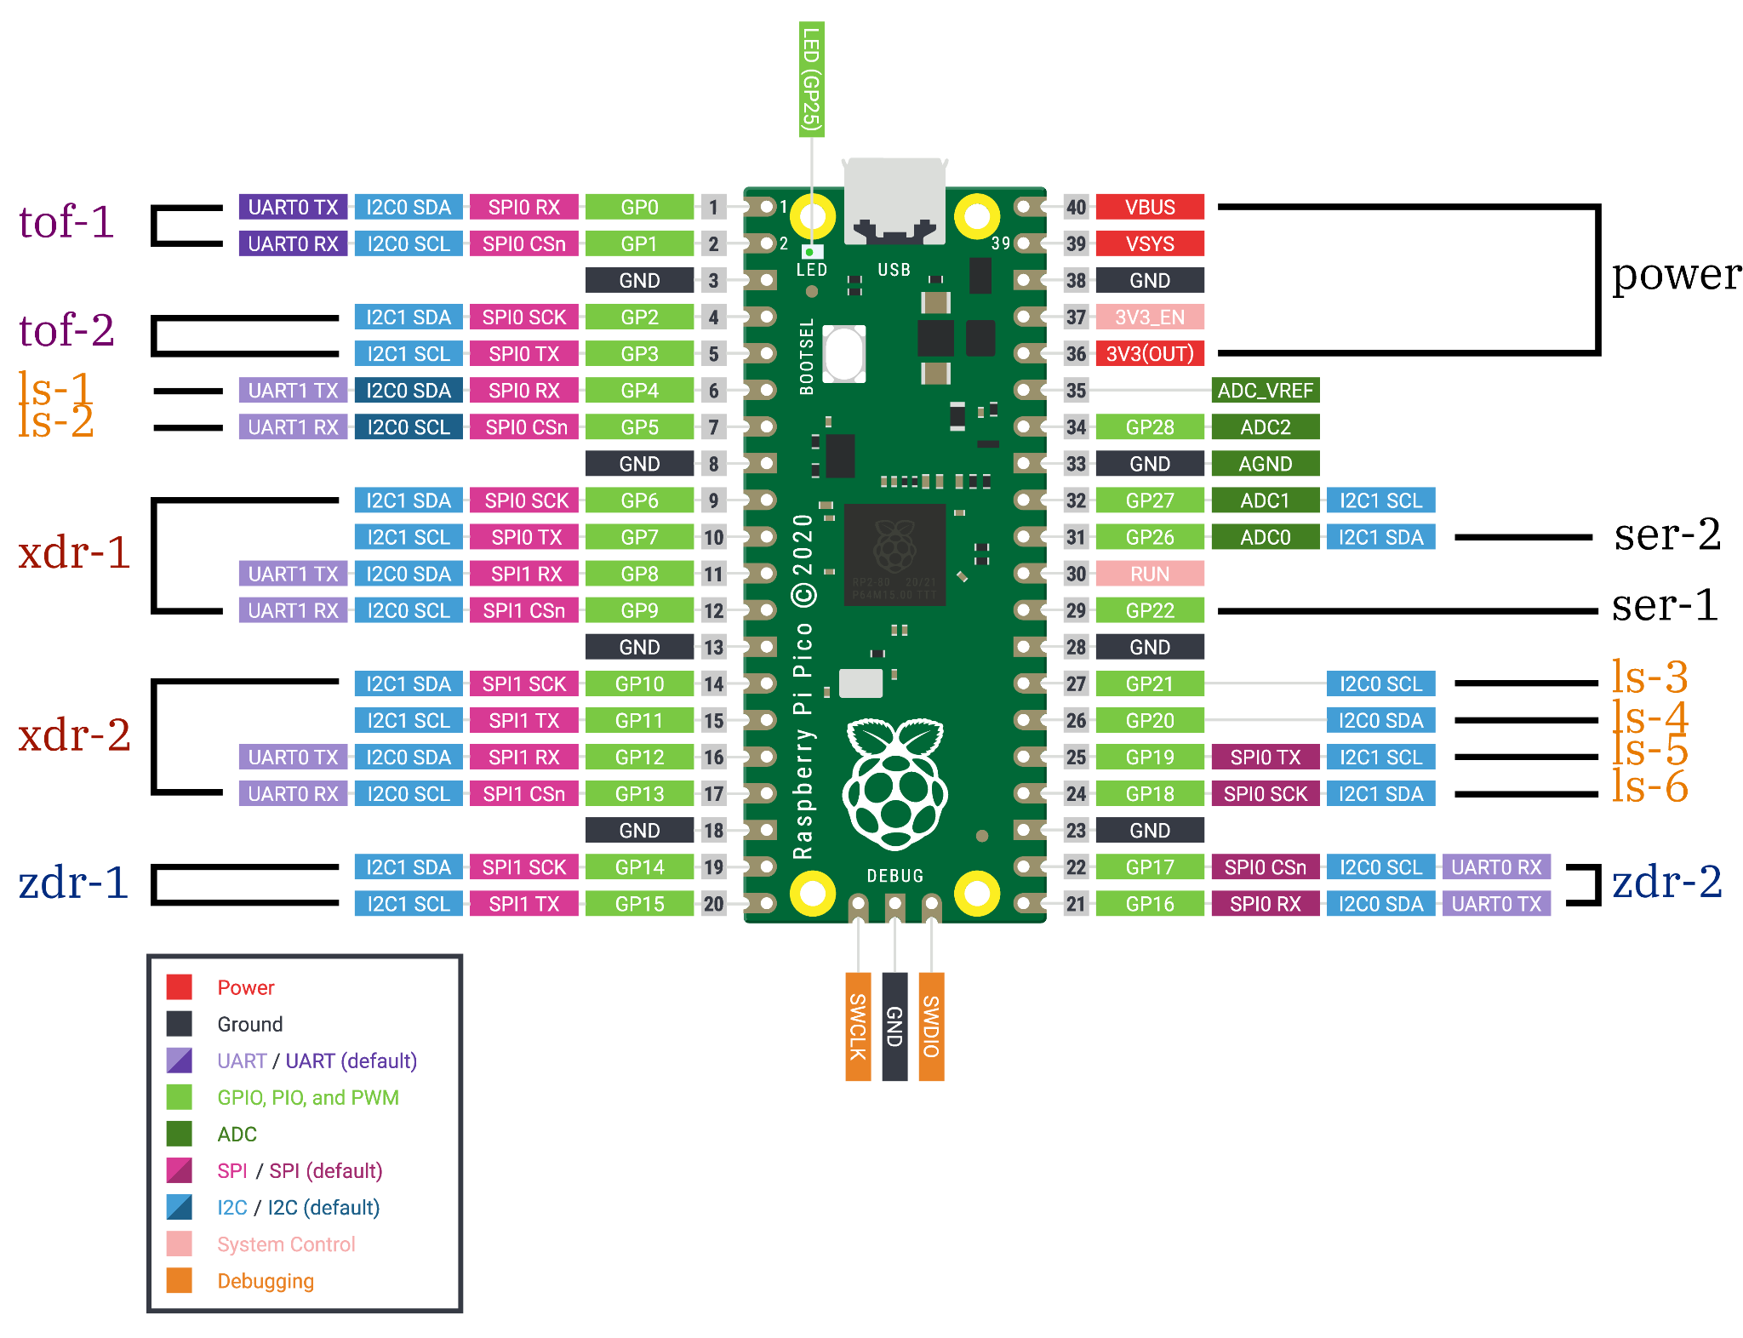
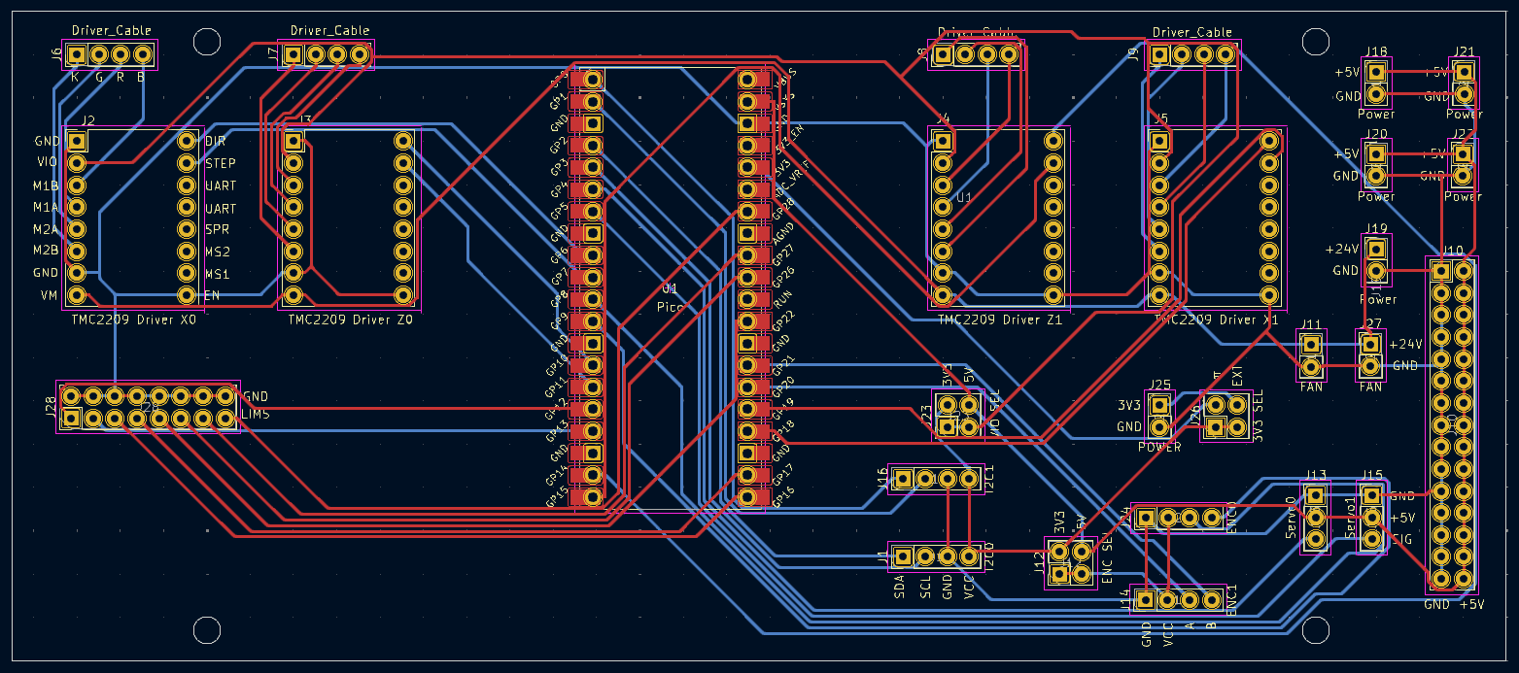
Sensors & Electronics - Prateek
Motors: (6x)
XDR & ZDR
Each stepper driver receives 2 PWM signals (step, dir)
Encoders output 2 PWM-like signals
Enclosure
Each servo receives 1 PWM signal
ToF: (2x)
1x I2C each
Utilizes separate controllers to avoid multiplexing
Limit Switches: (6x)
1 Digital Input per switch (high/low)
MECHANICAL SCIENCE & ENGINEERING
GRAINGER ENGINEERING
Notes:
bring lead screw

Slide 18
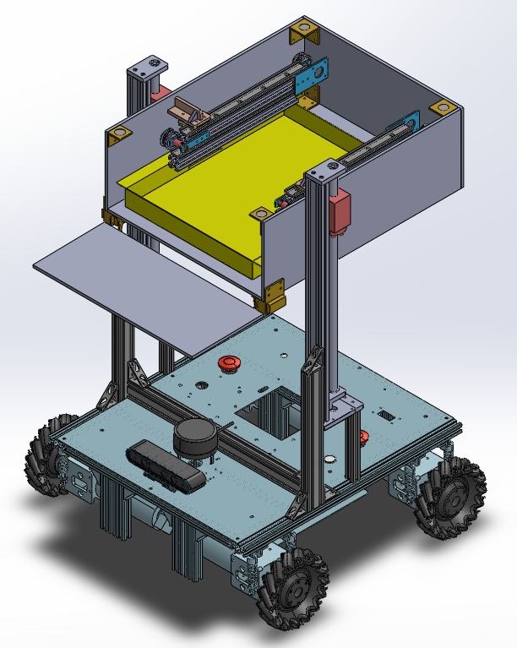
Overall CAD - Rohan
MECHANICAL SCIENCE & ENGINEERING
GRAINGER ENGINEERING
Notes:
bring lead screw

Slide 19
Testing - Rohan
Assembly and Mechanical Testing
Fully assembled apparatus was subject to load testing
5 kg load through sample tray
Measured Deflection: ~4.5mm
Software Testing
Startup from random points
Various enclosure, XDR, & ZDR positions
Zeroing and Homing software robust
MECHANICAL SCIENCE & ENGINEERING
GRAINGER ENGINEERING
Notes:
bring lead screw

Slide 20
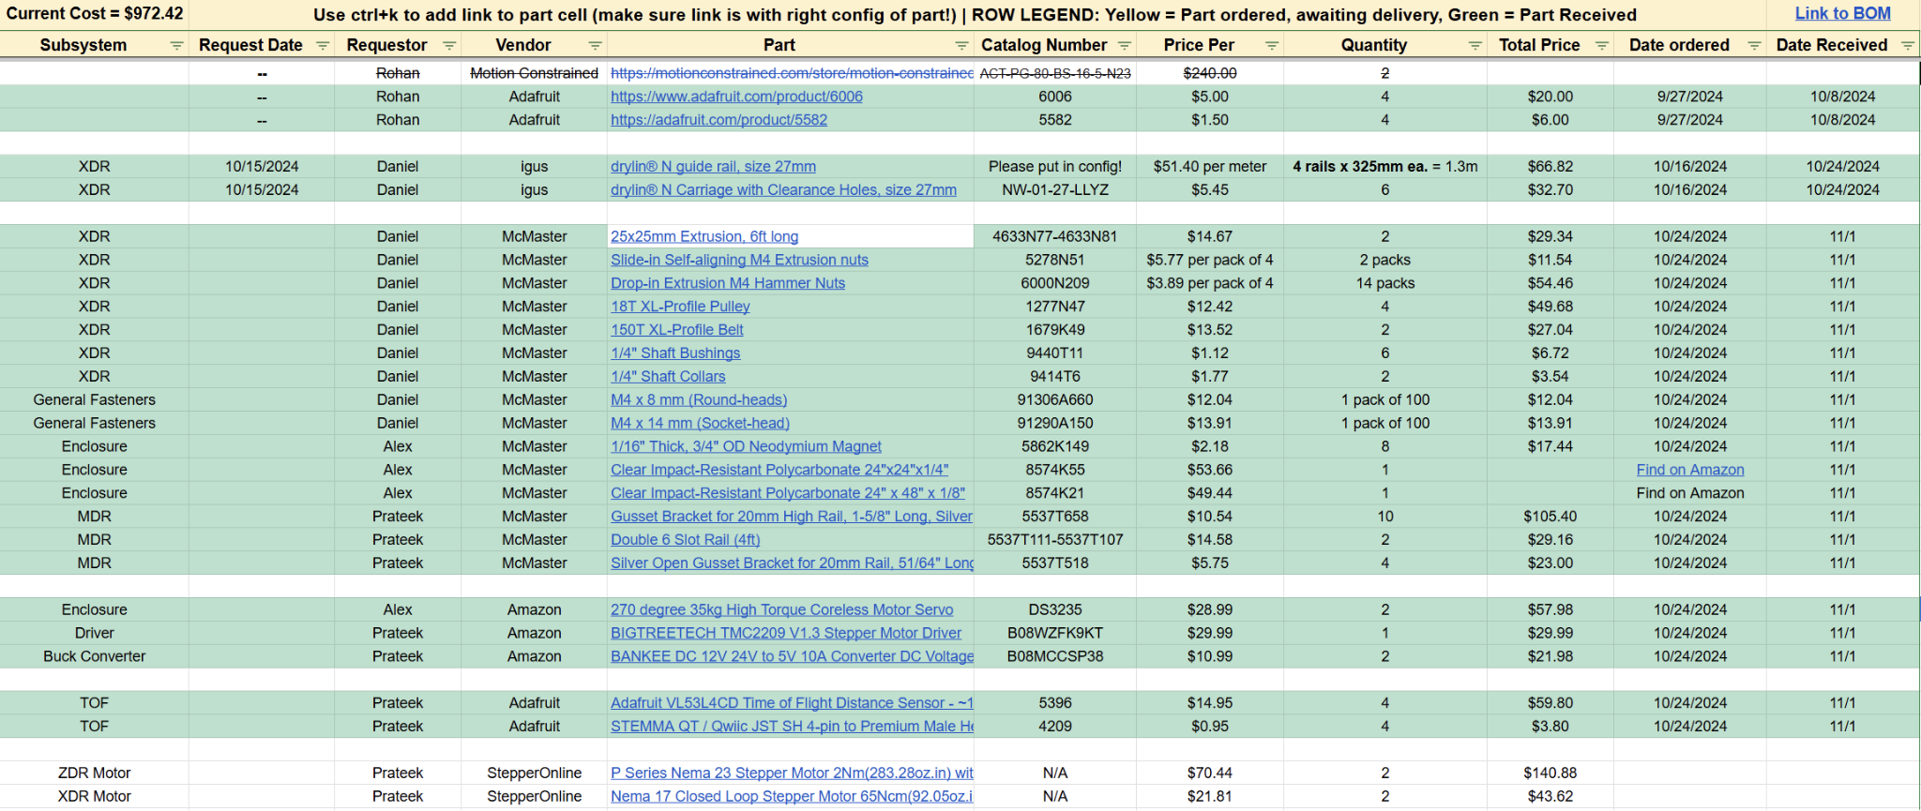
Overall Budget - Daewon
Total Cost:
$972.44
MECHANICAL SCIENCE & ENGINEERING
GRAINGER ENGINEERING
Notes:
bring lead screw

Slide 21
Future Steps - Daewon
Mechanical
Tolerance tightening in XDR Slider System
Decrease deflection
Lessen friction
Switch to Metal parts
Structurally stronger
3D printed parts liable to cosmetic defects
Software and Electronics
Real-action testing required
Failure Modes (FMEA) to be studied and prevented
Safety Interlocks
MECHANICAL SCIENCE & ENGINEERING
GRAINGER ENGINEERING
Notes:
bring lead screw

Slide 22
Special thanks to:
Mattia Gazzola
Zhantao Song
Diya Patel
Hongbo Yuan
MECHANICAL SCIENCE & ENGINEERING
GRAINGER ENGINEERING

Slide 23
Gamsahapnida 🙏🏼
Questions
MECHANICAL SCIENCE & ENGINEERING
GRAINGER ENGINEERING

